Slide 1


AI-driven Sales Orchestration

Slide 2


Problem: LATAM’s Sales Execution Gap
Billions USD of potential supplier to retailer sales are lost due to inaccurate customer personalization and insufficient business analytics.
Companies in
Latin America
Sales Lost
Traditional
Channels
B2B Sales Execution
Gap
Sales
FMCG
DATAR
AI Based
Pharmaceutical
& Digital
Channels
BI Based
Hardware
Actual
Time

Slide 3




Solution
Personalized sales recommendations
DATAR is an artificial business intelligence platform to automate and optimize large-scale sales operations.
Strategic promotions
Product portfolio
expansion

Slide 4
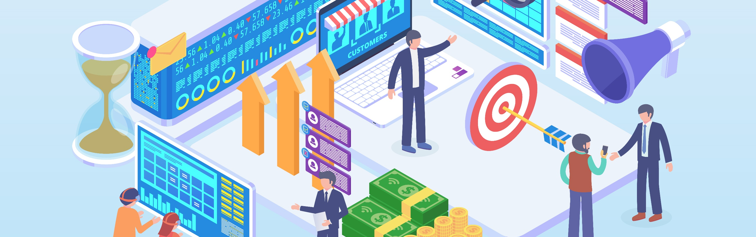
Market: Traditional and Digital B2B Sales Channels in LATAM
+20K
+5M
+1M
Companies
of fabricants
& distributors
Points of Sales
small & medium size
Sellers
visiting medium & small stores
~US$ 500B
Sales / year
~US$ 1B
DATAR TAM

Slide 5

Product
AI Platform for Sales Orchestration

Slide 6










Plug-&-Play Platform
Deployment to Sales Channel
+
+
Data Mining of
Sales Patterns, Inventory and Market Data
Recommended
Product for Retailer!
=
=
Current Portfolio for Customer
Retailer-specific sales actionables
+
+
New Product
Priority Products
Promotions
Real-time Machine Learning
“Special Recommendation”
“Regular Recommendation”

Slide 7

Our machine learning algorithms generate personalized sales recommendations and actionables for thousands of customers.
Machine Learning

Slide 8
Scalable Deployment and Usage
Automated Sales Orchestration
Data mining from any company’s sales system
Key sales
actionables and predictions
Personalized recommendations
and actionables deployed to sellers and digital commerce.
Machine
learning

Slide 9
Pricing Model
10/ month per seller
$
Plan Includes
Programmatic connection to sales system and order taker.
Sales recommendations and actionables engine.
Automatic daily follow-up reports at 3 levels.
15% discount
600- 5000 sellers.
30% discount
5000+ sellers.

Slide 10

Success Cases
>30%
~65%
>3x
Rebuys of special recommendations
Effectiveness:
Sales recommendations over orders
ROI:
over clients’ EBITDA
3-7%
15-25%
Sales growth
monthly per seller
Incremental products per store

Slide 11
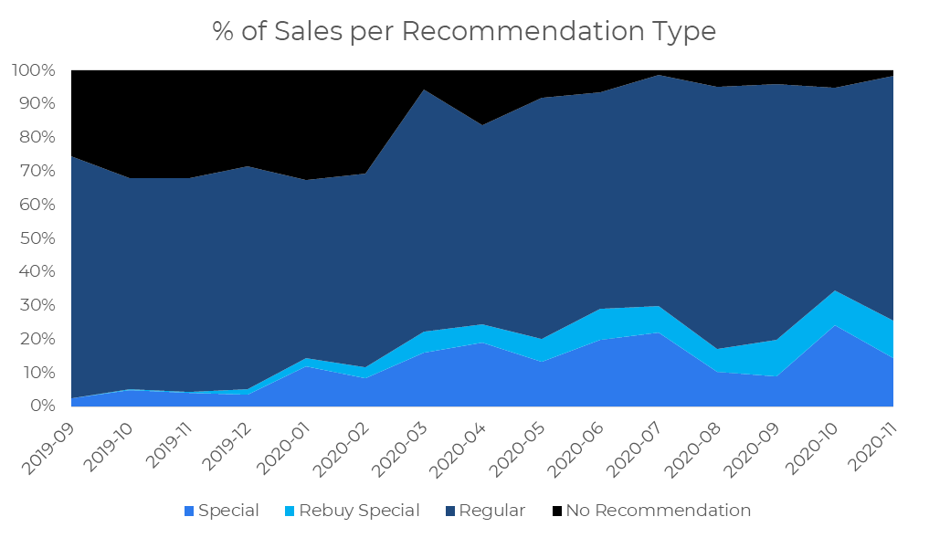
Traction & Success Cases
DATAR Revenue
Q3 2019 + 2020
US$23K
FY 2022
US$100K
FY 2023
(In contract)
US$200K
FY 2024
(In contract)
US$300K
“It gives sellers the best product offering in each store” – Seller Comment

Slide 12
Competitive Advantage
ML models specialized in mid-size and small retailers in emerging markets.
Plug-&-play implementation
for multiple sales channels.
Demonstrated sales and market share growth

Slide 13








Automated
machine learning
Specialization in
B2B sales in emerging markets

Slide 14
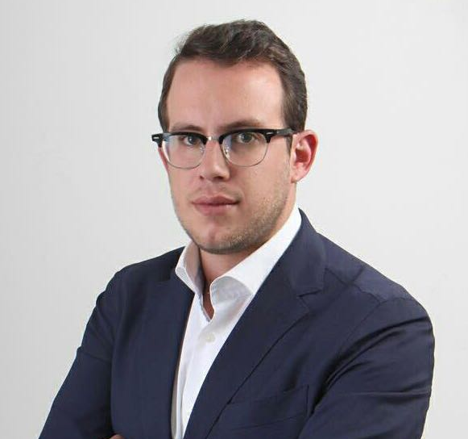
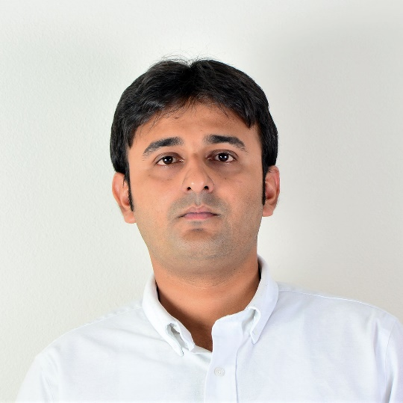

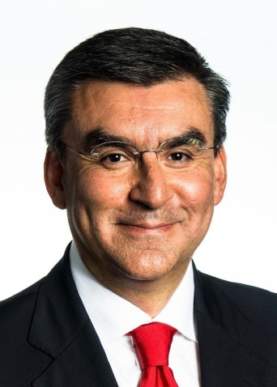
Team
CEO / Co-founder
Advisor
Machine learning
Advisor
Commercial Strat
CTO / Co-founder
Alexis Platonoff
Anjan Paul
Felipe Oviedo
Guillermo Aponte
Commercial and marketing FMCG expert.
1st place in the Global Coca Cola Awards 2015, in the service models optimization category.
Developed several algorithms for FMCG companies.
10 years working in Data Engineering, Big Data and Cloud Computing.
Experience developing data infrastructure for Fortune 200 companies in the US, Europe and India.
Certified developer in: IBM Watson, Amazon Redshift and Spark.
Machine Learning PhD at MIT.
7 years experience, over 50 publications in applied machine learning.
Machine learning researcher @ Microsoft Research and CERN.
Arca Continental (3rd largest Coca-Cola Bottler worldwide)
CEO – South America Division
CEO – USA and Latam Food & Snacks Division
The Coca-Cola Company
President and GM, Philippines
GM Mexico, Colombia
CEO & Founder SrtatVizor LLC
Diaz Food (USA), Board of Directors
Source To Bottle (USA), Advisor & Investor

Slide 15
Cashflow
Investment: $750k
11%
Fixed Assets
7%
Runway: ~ 2.5 years.
Target Billing: ~ $900K / year.
Impact: 7000+ sellers.
Market Expansion: Central America, South America, Mexico
Developments
Working Capital
53%
29%

Slide 16

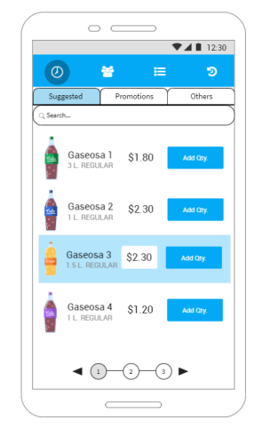
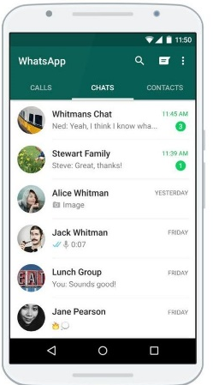


Investment: Toward DATAR Scalability
Commercial Engine
Multi-Channel
AI Consultant for strategies, promotions
& supplying
Traditional order-taker
WhatsApp client
Call Center
E-commerce
platforms

Slide 17
Improve your sales through AI
Altamente Confidencial

